Slide 1
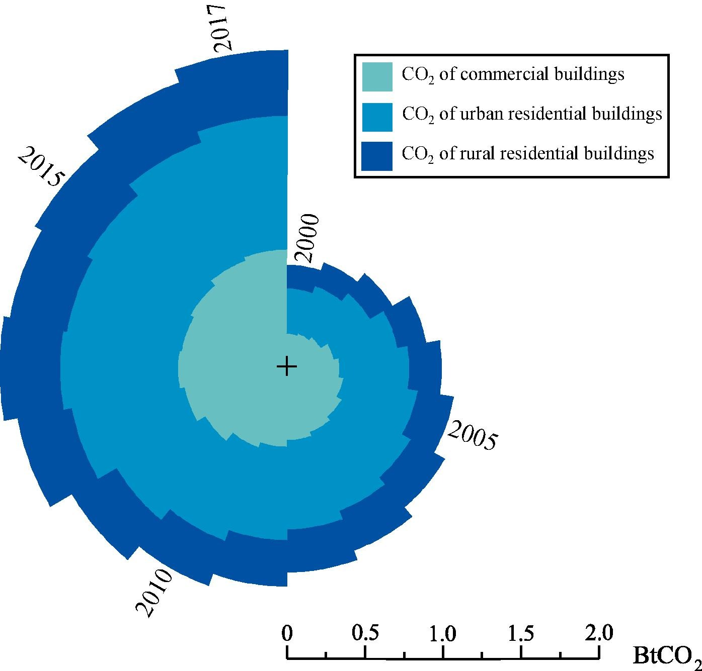

Slide 2
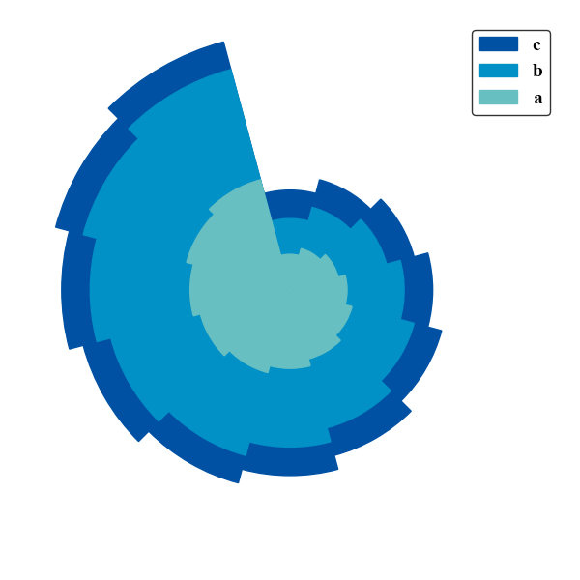

Slide 3


2021
2011
2013
2019
2015
2017
0
20
40
60
80

